Slide 1
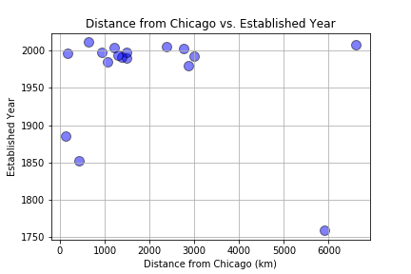
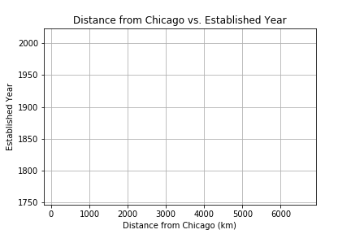
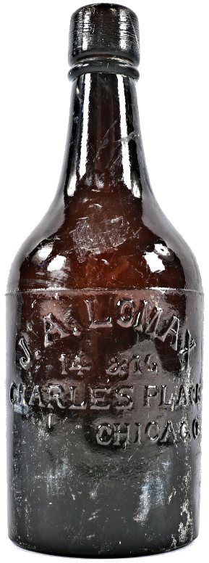
Is there a correlation between the Established Year of a brewery and it’s Distance from Chicago?
Why Chicago?
Chicago was one of the “hot-spots” for brewing in early America, thanks to the large population of German immigrants living here.
Do we still see a clustering of older breweries closer to Chicago?
With enough time (and prohibition) this trend might no longer exist.
*Hypothetical Data – if the correlation still exists

Slide 2
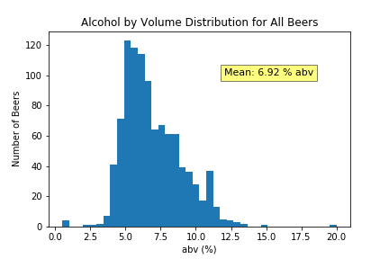
Does alcohol by volume (abv) differ significantly between beer styles of different regions?
Our average alcohol content over all beers is 6.92% by volume.
Our data set includes: 1109 individual beers
Note: the average abv for beer according to Google is 4.5%*
Click here for something cool (insert link to Aaron’s Dash app thing)
*REF: https://www.livescience.com/32735-how-much-alcohol-is-in-my-drink.html

